Slide 1

Insights for Telangana Government Tourism Department

Slide 2
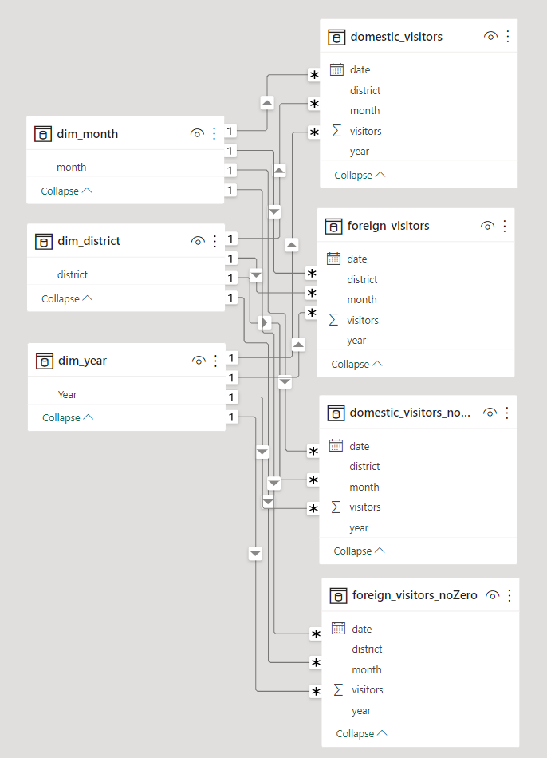
Data Model
Data set used for this analysis:
1) Code basics => data set from 2016 – 2019
2) Telangana Gov. Website => data set 2020
https://data.telangana.gov.in/dataset

Slide 3
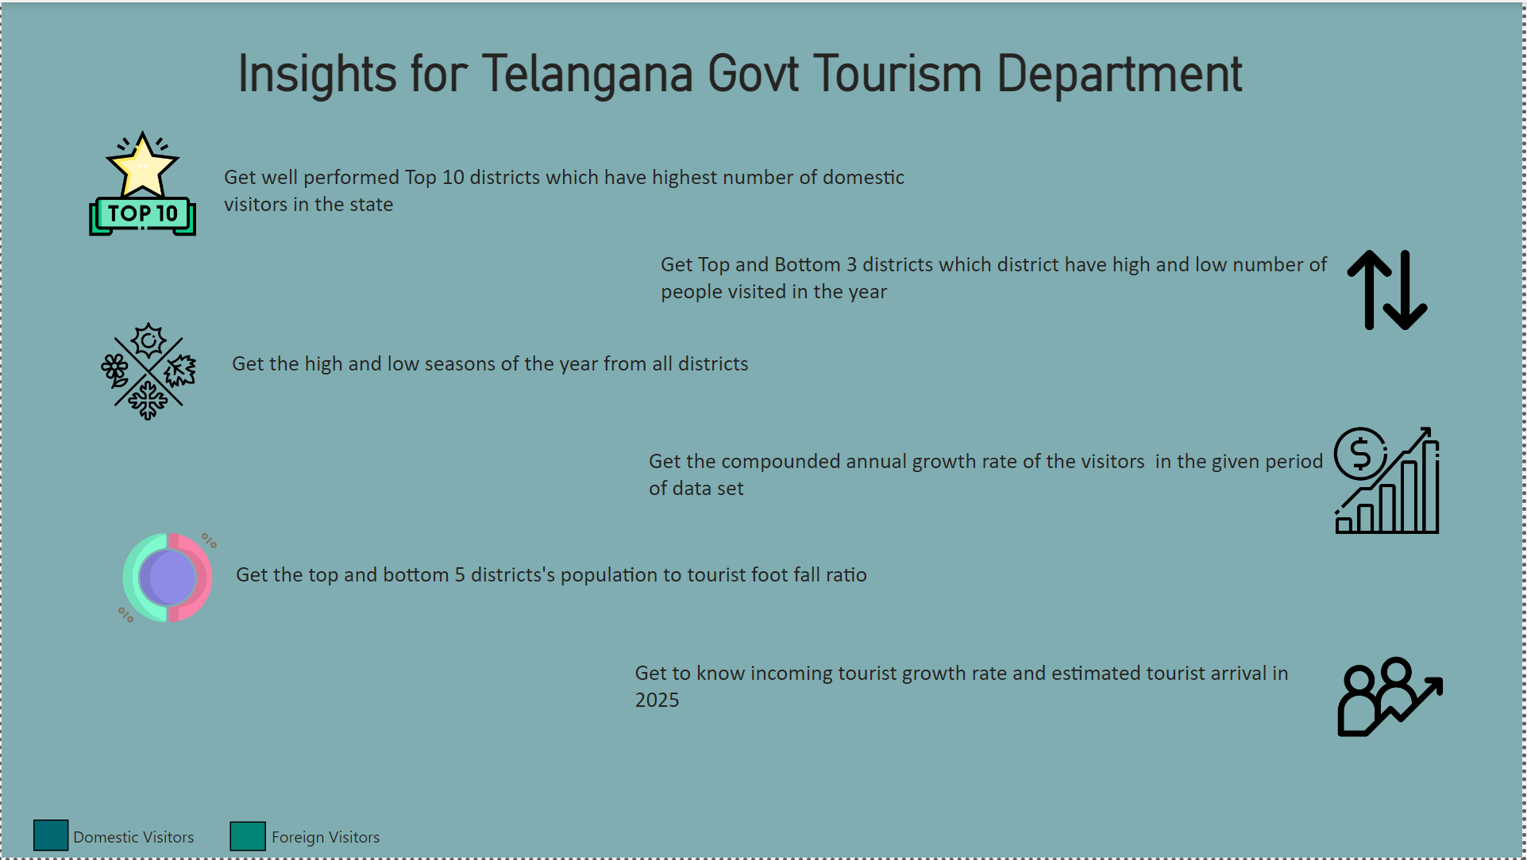

Slide 4
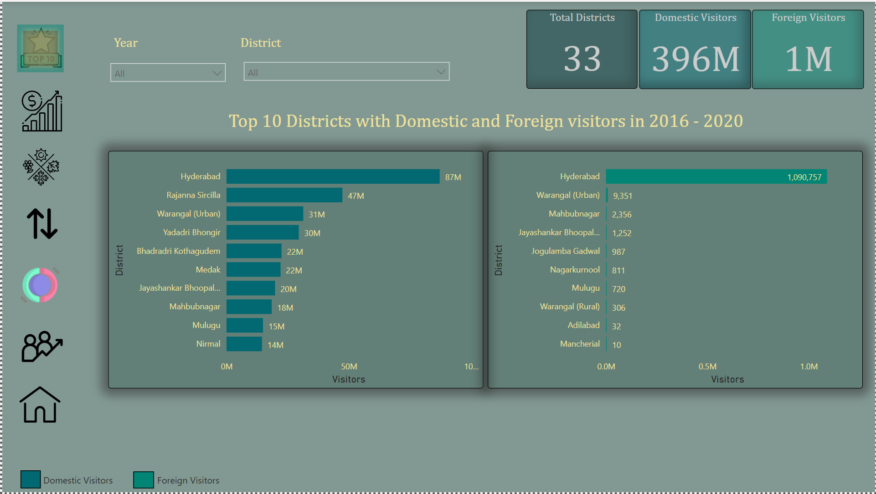

Slide 5
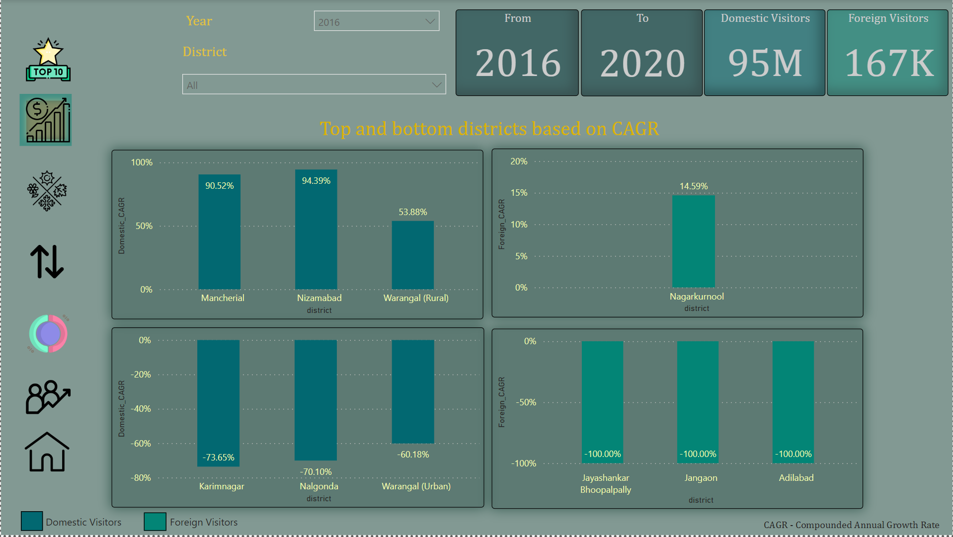

Slide 6
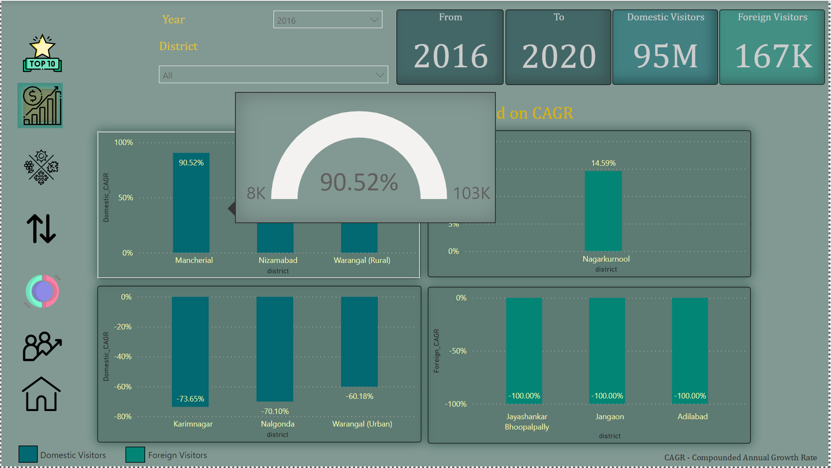

Slide 7
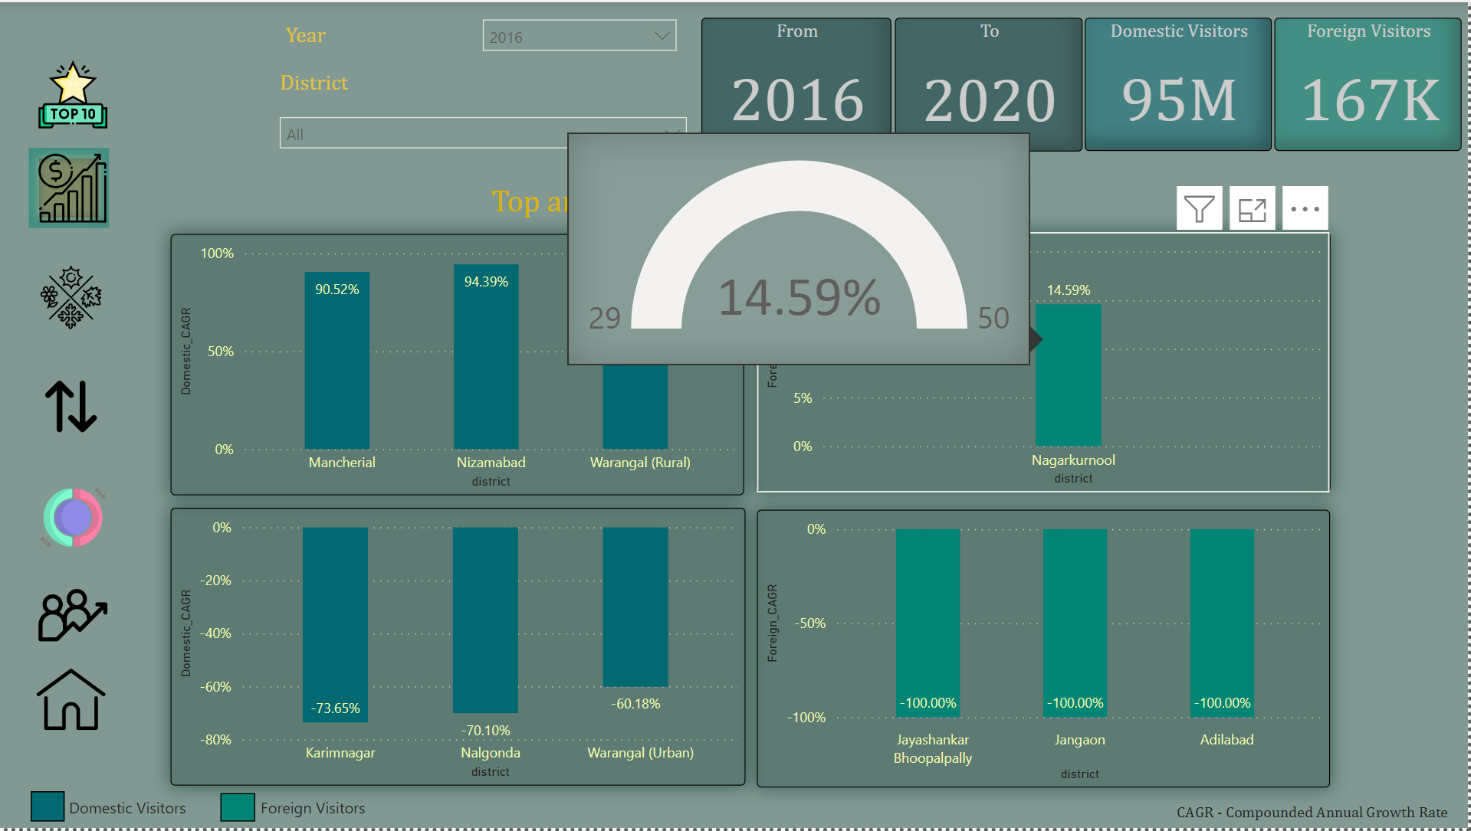

Slide 8
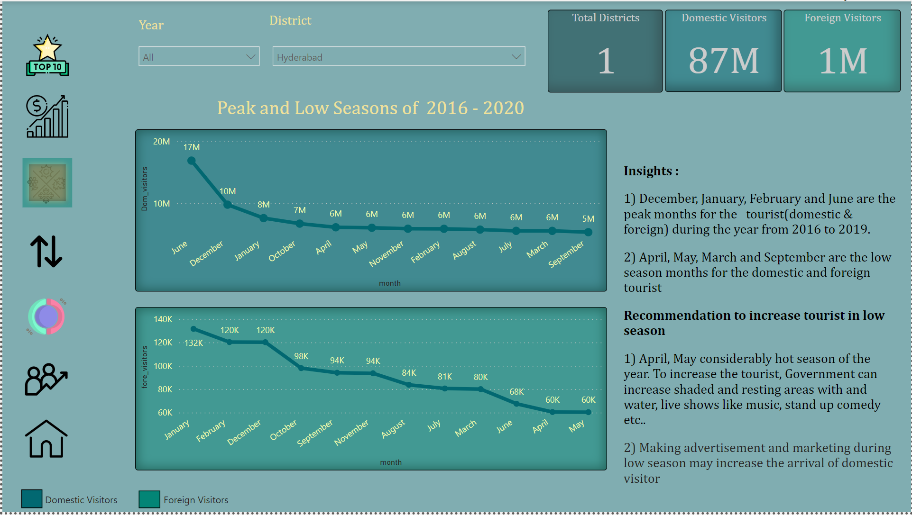

Slide 9
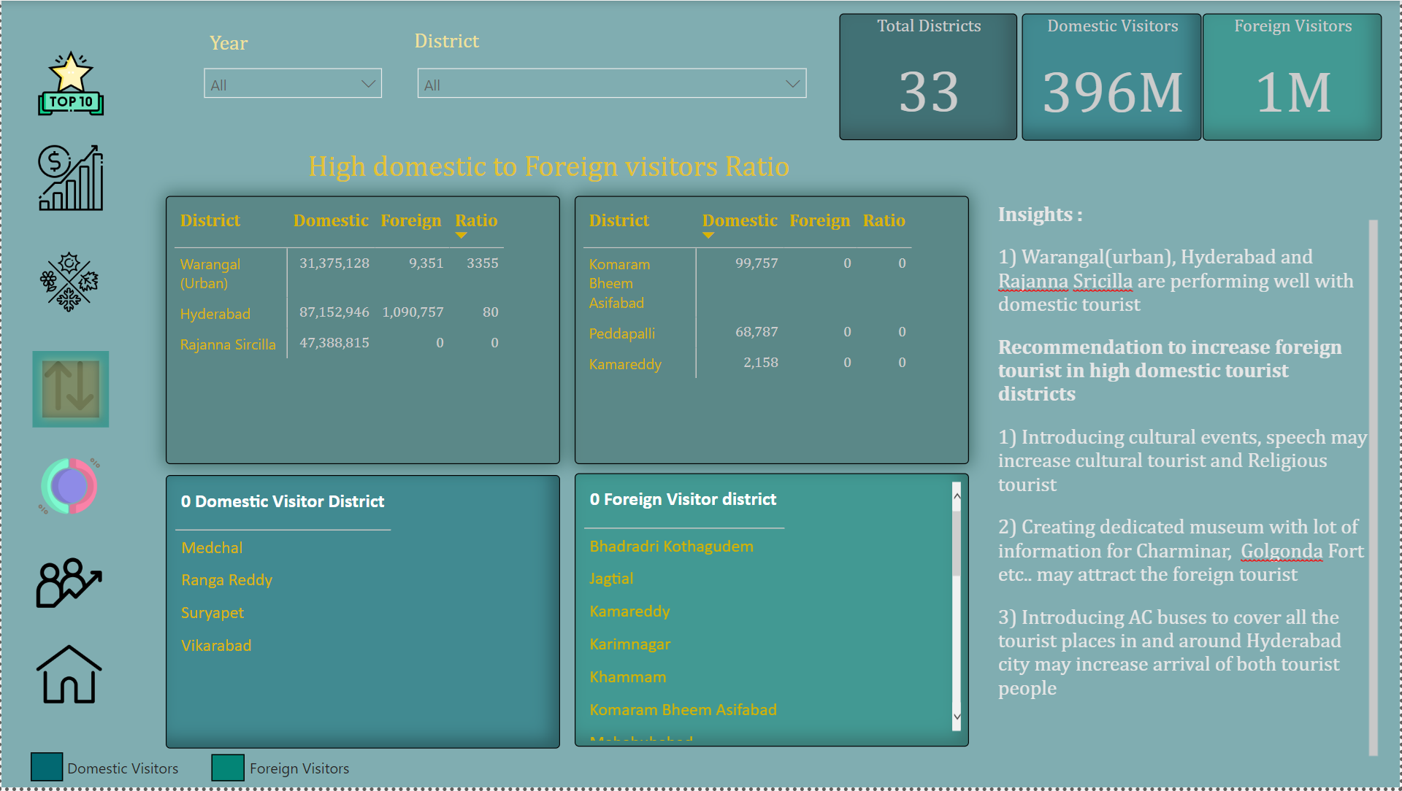

Slide 10
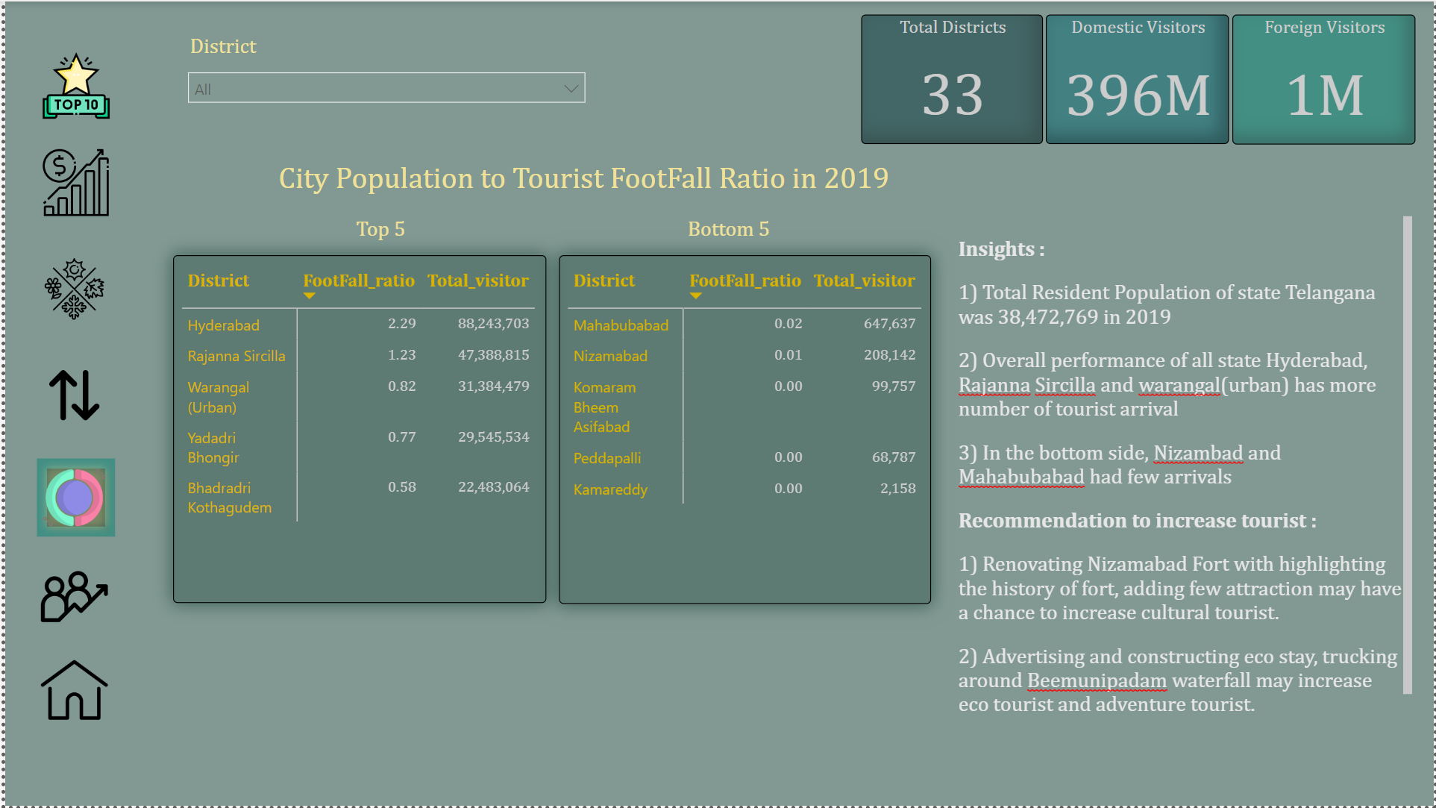

Slide 11
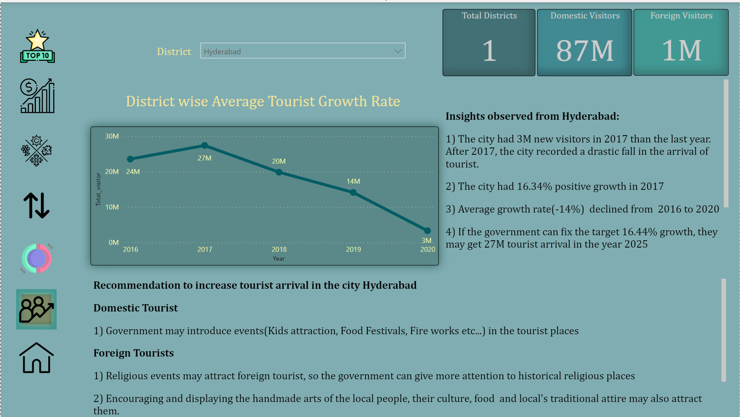

Slide 12

Thank you for sparing your valuable time

